Slide 1
BIGDATA PROJECT DEMO
Venkata Vinay Kumar Marpina – vxm133430
Venkatesh Avula – vxa141230
Vijay Krishn Vantipalli – vxv140430
Karthik Velaga - kxv140730

Slide 2
Project Description
Objective - 1
“Spam E-mail classification using Big Data and Machine Learning Concepts”
- Data set : Text Retrieval Conference(TREC) - 2005 Spam Corpus
- Size: 1.04 GB (Extendible)

Slide 3
Project Description
Objective – 2
“ Predict user ratings for films based on previous ratings with out any other information about the users or films and recommend movies with more than ‘3.5’ rating.”
-Data Set: Netflix Prize Competition Data
-Size : 80Mb(Extendible)

Slide 4
Spam E-mail Classification
Data Representation:
Data contains Indexfile.txt consists of class label and test file name
Data contains two class labels called Spam and Ham
Giga bytes of data presented in one big folder with hundreds of inside folders containing hundreds of text files.
Data is not well formatted.

Slide 5
Spam E-mail Classification
How to Work with this unformatted BIG DATA?

Slide 6
Spam E-mail Classification
Hadoop Concepts:
Implemented a Mapper/Reducer Code to get all the information in Index file which contains the text file names and respective class labels.
Once we have class label and list of file names belong to that class we implemented JOB chaining concepts to run another Mapper/Reducer.
This Mapper/Reducer moves the text files from one central location to separate location based on their class label.

Slide 7
Spam E-mail Classification
Hadoop Cont.…
Once we have text files in their respective allocated folders Spam/Ham we are processing theses files to remove noisy data.
We implemented a Mapper/Reducer to remove noisy data like ‘!@#$%^^&*()’ and unwanted spaces. This code provides us with a big text files containing words with ‘ , ’ separation.
we need lot of time to process this mega bytes of text files using simple java concepts so we use some more map reduce concepts to reduce processing time.

Slide 8
Spam E-mail Classification
Hadoop Cont.…
We will use one more Mapper/Reducer to count all the words present in the big text files and with that information we will build a vocabulary text file.
In the vocabulary we will have all the words which occurred at least once.
Now with this formatted and produced data, we will implement a classifier to train. Using this trained classifier we will classify the new Test data as Spam or Not Spam E-mail.

Slide 9
Spam E-mail Classification
Machine Learning:
Once we have the sorted and produced data properly we will use Machine Learning concepts to train and test the data.
We implemented two Machine learning text classifiers
Naïve Bayes
Logistic Regression
Each classifier uses different type of training and prediction techniques.

Slide 10
Spam E-mail Classification
Machine Learning Cont.….
Both these classifiers takes vocabulary generated using Hadoop concepts and Spam/Ham big text files as input for training purpose.
Naïve Bayes classifier uses word count in each file to calculate the conditional probability of the words using Bayes Theorem concepts for training purpose.

Slide 11
Spam E-mail Classification
Machine Learning Cont.….
Once training is completed in Naïve Bayes it uses the conditional probabilities of each word to calculate the over all probability of the document given class labels to predict the new email class label.
Logistic Regression uses the concepts of weights to train the data. It uses the following equation to update the weights.
wi ← wi +η∑ l X l i (Y l −Pˆ(Y l = 1|X l ,W))

Slide 12
Spam E-mail Classification
Machine Learning Cont...
Once training is done we will uses the learned weights to calculate the over all weight of the document to test the new text file classification.
Both classifiers are stable classifiers. So the prediction accuracy is pretty good with the given data.
Both the classifiers reaches accuracy more than 80%
We can improve the accuracy of the classifiers to almost 85 to 90% using some other special techniques.

Slide 13
Key Findings/Results
Accuracy on Sample Data:
Naïve Bayes : 83.095%
Logistic Regression : 84% to 89%(multiple tries)
Logistic Regression accuracy can be Improved by removing stop words and fine tuning of the parameters

Slide 14
Movie Rating Prediction
Data Description:
This data is taken from Netflix and contains movie ID, User ID, Movie rating, Movie title.
The data set contains 1821 movies , 28978 users.
Training set contains 3.25 million rows and test set contains 100,000 rows
Data is well formatted but data is in multiple files with unique id as Movie ID. Required some Big joins to club the data into one Big file.

Slide 15
Movie Rating Prediction
How to Predict Movie Ratings with Out any Information about users/movies?

Slide 16
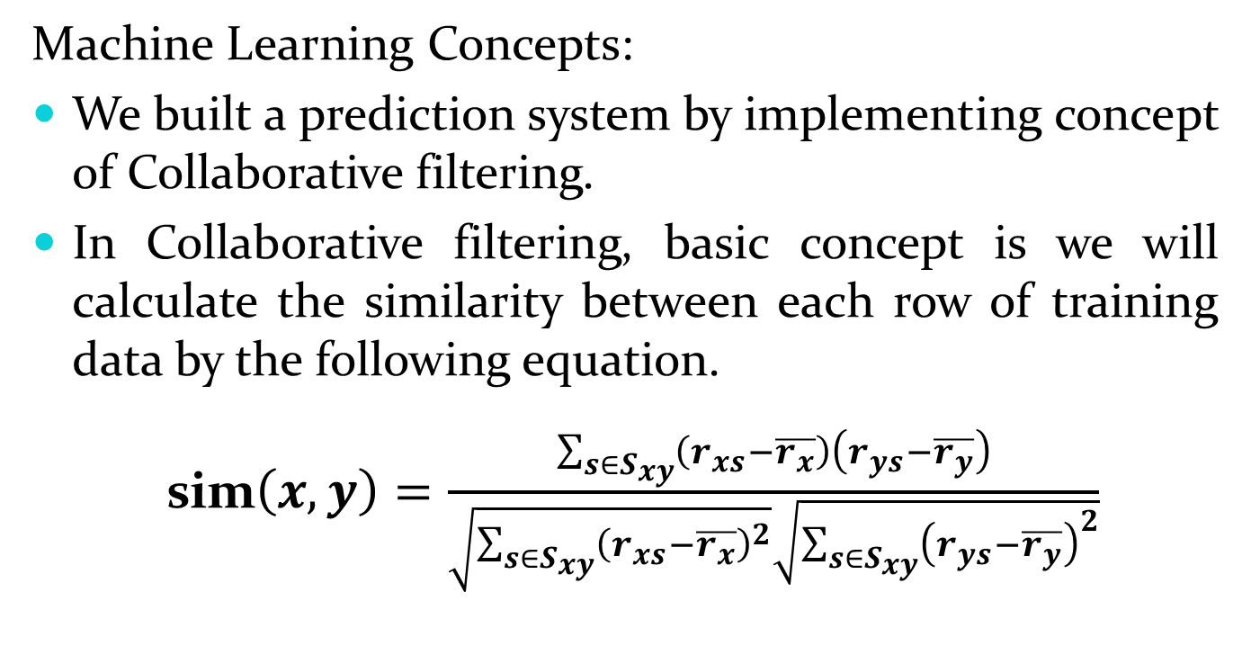
Movie Rating Prediction
Machine Learning Concepts:
We built a prediction system by implementing concept of Collaborative filtering.
In Collaborative filtering, basic concept is we will calculate the similarity between each row of training data by the following equation.
sim$\left(x,y\right)=\frac{\sum_{s∈S_{xy}}{\left(r_{xs}−\overline{r_{x}}\right)\left(r_{ys}−\overline{r_{y}}\right)}}{\sqrt{\sum_{s∈S_{xy}}{{\left(r_{xs}−\overline{r_{x}}\right)}^{2}}}\sqrt{\sum_{s∈S_{xy}}{{\left(r_{ys}−\overline{r_{y}}\right)}^{2}}}}$

Slide 17
Movie Rating Prediction
Once all the similarities are calculated the rating prediction is done for new test row by the following equation
The rating prediction mean absolute error is around 0.79

Slide 18
Movie Rating Prediction
Once the prediction rating is done still the output contains only the Movie ID and predicted rating. We need to recommend the user based on movie title.
So, we need to join the out put from the collaborative filtering with another data file which contains movie id and movie title.
For that purpose we use PIG concepts for the JOIN and filtering based on the average ratings.

Slide 19
Movie Rating Prediction
PIG Concepts:
Once we have the predicted ratings text file as output from the Machine learning algorithm we are calculating the average predicted ratings of the given movie.
Once we have average ratings we are joining this with the Moviestitle.txt to get the Movie title in place of Movie Id.
We are using the filter on ratings to recommend movies with rating more than ‘ 3.5 ‘

Slide 20
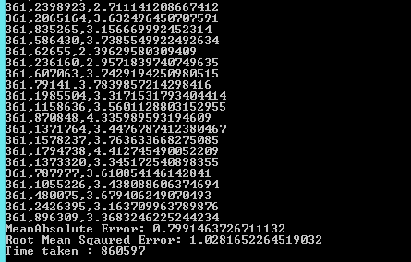
Key Findings/Result
Predicted Ratings:
Movie ID , User ID, Predicted Rating

Slide 21
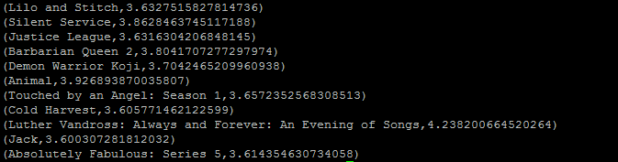
Key Findings/Result
Predicted Rating >3.5

Slide 22
References
1) Big Data Management and Analytics lecture slides provided by Dr Lathifur Khan
2) http://nlp.stanford.edu/IR-book/pdf/13bayes.pdf
3) Empirical Analysis of Predictive Algorithms for Collaborative Filtering by John S. Breese
4) http://hadoop.apache.org/docs/current/hadoop-mapreduce-client/hadoop-mapreduce-client-core/MapReduceTutorial.html
5) https://pig.apache.org/

Slide 23
THANK YOU

